Slide 1
SMS- SPAM CLASSIFIER
ANALYTICAL PROJECT
RAGUL BALAJII SS
COIMBATORE INSTITUTE OF TECHNOLOGY

Slide 2
Agenda
Problem Statement
Proposed System/Solution
System Development Approach
Algorithm & Deployment
Result
Conclusion
Future Scope
References

Slide 3


Problem Statement
As we navigate through the digital world, spam messages have become an increasingly common and annoying problem. To address this issue, I worked on building a spam classifier. The goal of this project is to develop a model that can accurately distinguish between legitimate (ham) messages and unwanted (spam) messages in a dataset of SMS messages
Increase in Spam
Need for Automatic Detection

Slide 4
Proposed Solution
The proposed solution involves machine learning algorithms to analyse and predict the possibilities of spam messages. The solution comprised of the following steps..
Data Collection
A dataset containing 5,575 messages, including both spam and ham messages, has been collected from Kaggle
DATA PRE-PROCESSING
Lowercasing: Convert all text to lowercase for consistency.
Handling Missing Values: Address missing values by removal, replacement with "unknown," or using the most common word
MACHINE LEARNING ALGORITHM
DEPLOYMENT
Naive Bayes
EVALUATION
Normalization: Standardize text features, such as word frequencies, to improve performance.
Developed an interactive interface that predicts whether entered messages are spam or ham.
Accuracy Score : The proportion of true results among the total number of cases examined.
Precision Score : The proportion of true positive results among all positive results predicted by the classifier and results in confusion matrix.
Vector Machine (SVM)
Decision Tree
ClassifierRandom Forest : RandomForestClassifier
AdaBoost : AdaBoostClassifierBagging
Classifier : BaggingClassifier
Boosting : GradientBoostingClassifier
XGBoost : XGBClassifier

Slide 5
SYSTEM APPROACH
System Requirements:
Processor: A modern multi-core CPU. Most mid-range and high-end CPUs will suffice.
Memory (RAM): At least 4 GB of RAM, although 8 GB or more is recommended for smoother performance, especially if dealing with larger datasets.
Storage: Sufficient disk space to store the dataset, model, and any dependencies. A minimum of 1 GB of free space is recommended.
Internet Connection: Required for downloading NLTK data and any necessary libraries.
Library Required To Build the Model:
Pandas
Pickle
Nltk
TfidfVectorizer
MultinomialNB
Wordcloud
Seaborn
Numpy
Sklearn
string

Slide 6
ALGORITHM AND DEVELOPMENT
Model training-Classifier Initialization: Various classifiers are initialized including SVC, MultinomialNB, DecisionTreeClassifier, LogisticRegression, KNeighborsClassifier, RandomForestClassifier, AdaBoostClassifier, BaggingClassifier, ExtraTreesClassifier, GradientBoostingClassifier, and XGBClassifier.
Training: Each classifier is trained using the fit method on the training data (X_train, y_train).
once the models are trained, they are used to make predictions on the test data.
Predicting Labels: Predict method is used to predict the labels for the test data (X_test).
Fitting the Model (fit method): The model learns from the training data by adjusting its parameters to minimize error.
Calculating Metrics: After predictions are made, the accuracy and precision scores are calculated to measure the model’s performance. The confusion matrix provides additional insights into the types of errors the model is making.
.

Slide 7
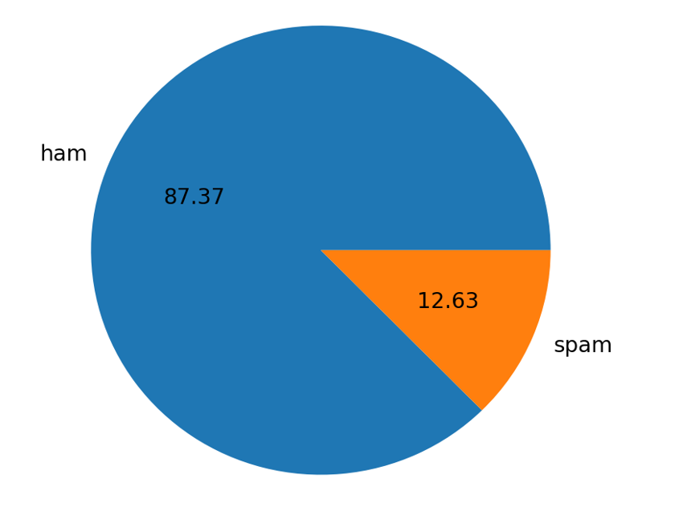
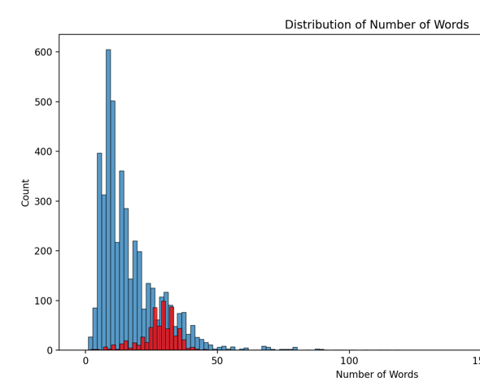
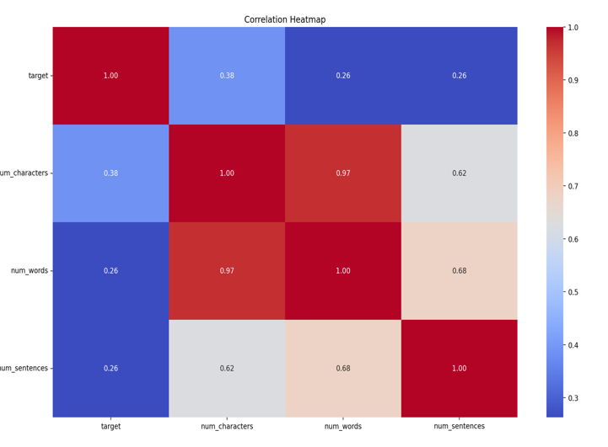
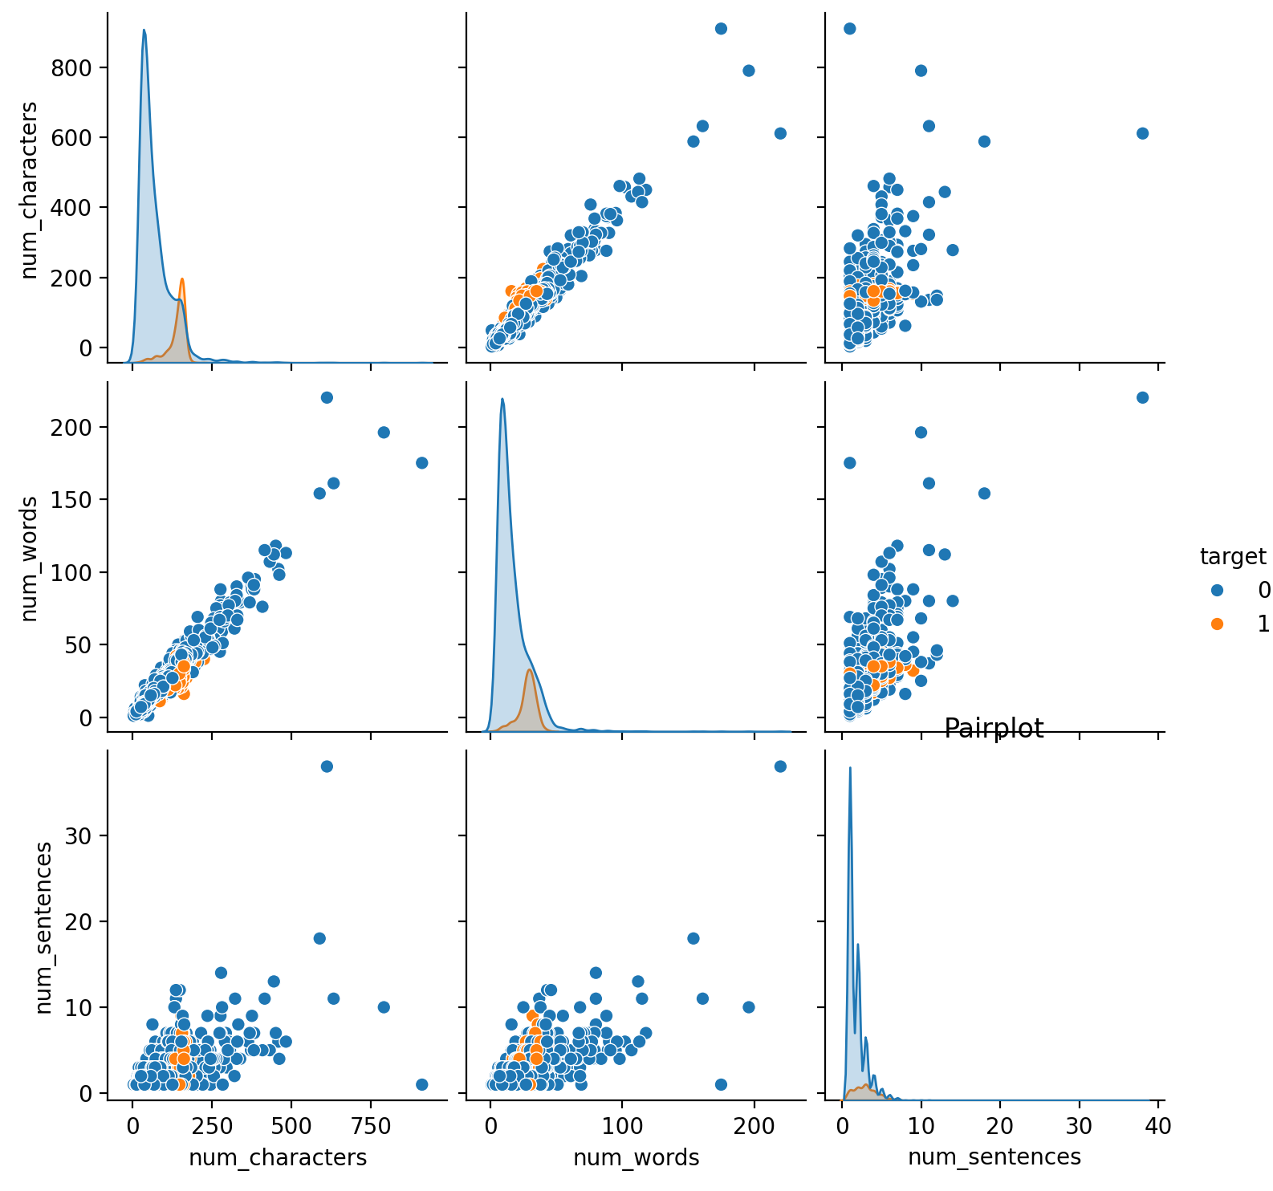
RESULT
.
Outputs
Examined target variable distribution (ham vs. spam).
Visualized class distribution with a pie chart.
Analyzed text statistics: characters, words, and sentences.
Created histograms for text statistics in ham and spam messages.
Generated pair plots and correlation heatmaps to explore relationships between text statistics.
Compared classifier accuracy and precision scores in a DataFrame.
Visualized classifier performance using bar plots.
Implemented a VotingClassifier (SVC, MultinomialNB, ExtraTreesClassifier).
Evaluated the ensemble classifier's accuracy and precision.

Slide 8
CONCLUSION
FINDINGS:
Class Distribution: The dataset was imbalanced, with more ham than spam messages, visualized via a pie chart.
Text Statistics: Spam messages had distinct text characteristics, like differing counts of characters, words, and sentences.
Model Performance: Various classifiers were evaluated. The ensemble VotingClassifier (SVC, MultinomialNB, ExtraTreesClassifier) achieved high accuracy and precision.
EFFECTIVENESS:
The Voting Classifier improved performance by combining the strengths of individual models . EDA and visualizations helped
identify key differences between ham and spam, aiding in effective feature selection.
CHALLENGES ENCOUNTERED:
Class Imbalance: More ham messages than spam could affect model accuracy; resampling or weighting may help.
Processing Time: Training multiple classifiers, especially in ensembles, was time-consuming.
Text Preprocessing: Consistent and accurate text transformation (tokenization, stopword removal, stemming) was essential for model performance.
.

Slide 9
FUTURE SCOPE
Spam Detection: Protects users from unwanted and harmful messages, enhancing user experience and security.
Business Applications: Helps organizations filter spam emails, improving communication and protecting against phishing.
Scalability: Methods and findings can be adapted for other text classification tasks, benefiting various NLP applications

Slide 10
REFERENCE
https://blog.logrocket.com/email-spam-detector-python-machine-learning/
https://towardsdatascience.com/build-sms-spam-classification-model-using-naive-bayes-random-forest-43465d6617ed?gi=703a2cccfd95
https://www.researchgate.net/publication/340607093_An_Effective_Model_for_SMS_Spam_Detection_Using_Content-based_Features_and_Averaged_Neural_Network

Slide 11
Thank you
RAGUL BALAJII S.S
COIMBATORE INSTITUTE OF TECHNOLOGY
SBRAGUL26@GMAIL.COM

